Slide 1
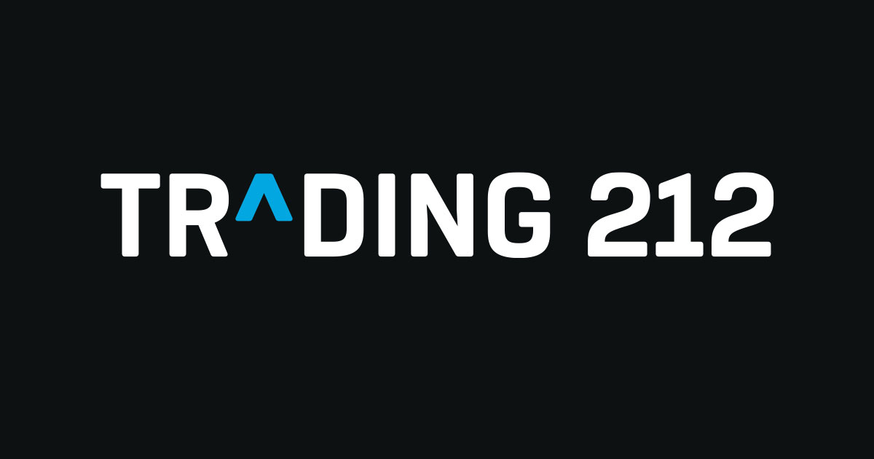




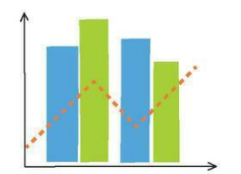
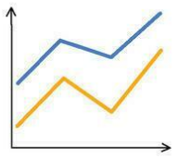
Stock Selection
Select 3 stocks using Trading 212’s volatility classifications (low, medium and high)
JPMorgan Chase & Co. (JPM) – Low
Coca-Cola Co. (KO) – Medium
Intel Corp. (INTC) – High
Data Collection
Download historical daily stock prices from Stooq (JPM, KO, INTC)
Approximately 44-46 years of data, where available
Use historical closing prices feature of website
Data Preparation and Feature Engineering
Clean and check datasets for missing values
Order data chronologically
Create predictive features (lagged prices and moving averages)
Create Linear Regression Model
Models linear relationship between historical prices and future prices
Uses lagged prices and moving averages
Implemented using Scikit-learn
Create Random Forest Model
Combines multiple decision trees
Captures non-linear relationships
Uses same input features
Implemented using Scikit-learn
Create Naïve Forecast Baseline
Assumes future closing price equals last observed closing price
Provides a simple benchmark for comparison
No machine learning model required
Generate Forecasts
Train models using historical data available up to a common cut-off date
Predict stock closing price 20 trading days ahead for each company
Generate one forecast per model and company (Total of 9 predictions)
20 Trading days Ahead
Evaluation and Comparison
Compare predicted and actual stock closing prices (3 actual prices)
Calculate absolute error and absolute percentage error
Present results in comparison tables and charts
Analyse differences in forecasting performance across the three stocks

